Slide 1


Remote Lab – one port calibration

Slide 2
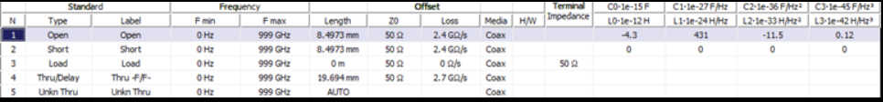

Step 1: need to obtain ideal representation of the open short and load, but from the book the told that at higher frequencies (higher than 5 GHz) we have to take into account third order equation correction based on the capacitance/inductance of the cal kits – they usually in the VNA system. I took cal kit from Keysight VNA loads
Let us start from OPEN:
Technically you can just do
This would be sufficient for our frequency, but I overcomplicated the code based on next slide:

Slide 3
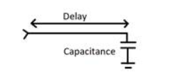


the coaxial open standard is an electrical “open” at the end of a short length of transmission line
for higher frequencies, open is modelled by a third-order equation as:
So from the book the equation transforms into this:
Where capacitance is Ce(f) Beta = 2pi/lambda

Slide 4
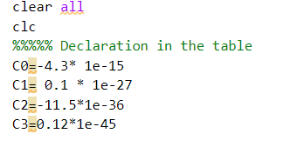
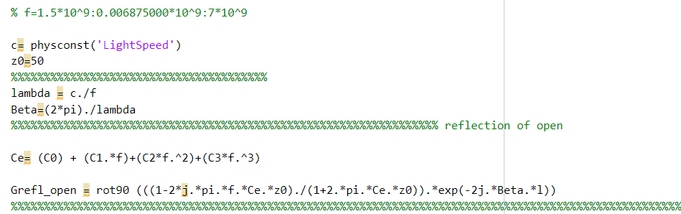
How it is in matlab code:
Don’t mind the rotation of matrix – it is just matlab likes to put it in line instead of in row.

Slide 5


Step 2: now we need to do the same with short
Ideal short is just Г=-1, but since I again did slightly harder
We will have same thing as capacitance
Leading to:
However, seems like nobody cares about it in agilent and CMT so they just model is as L=0
So not much difference here:

Slide 6
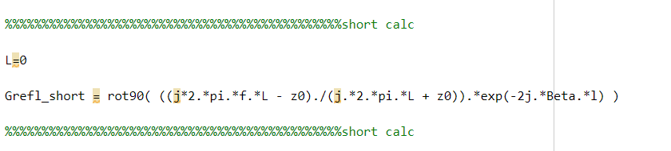
So we comes to this which doesn’t go far away from simple Г= -1
Finally the load – this one is the one who makes more challenges – this is because ideal load is just Г=0. This is what limits the calibration. Ideally would be to record the load with VNA and make it stored in the system, but for now I just did it like this:

Slide 7
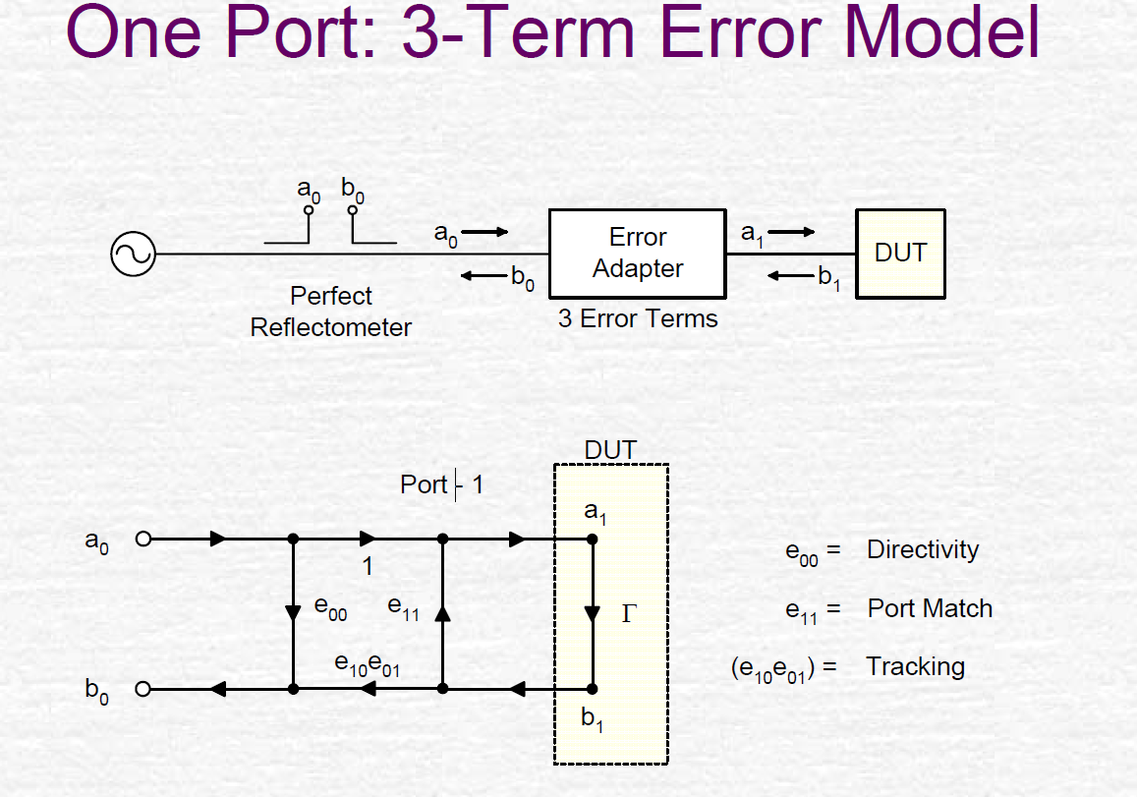
Recall: 3- term error models. Need to find 3 error terms e00, e11, e10e01

Slide 8
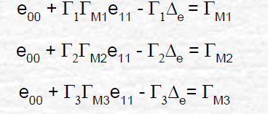
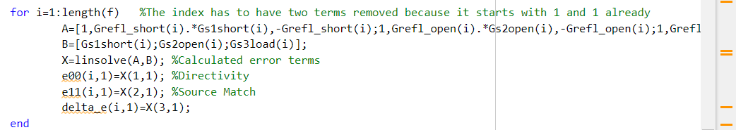
They are connected to the actual set of 3 equations
Гм1 = measured CAL kits
Simply using linsolve in MATLAB with matrixes

Slide 9
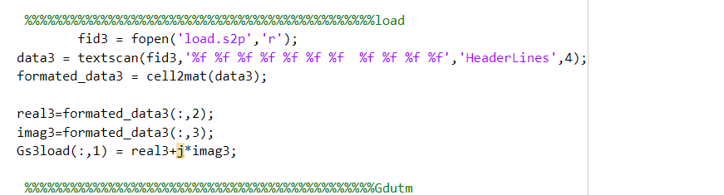
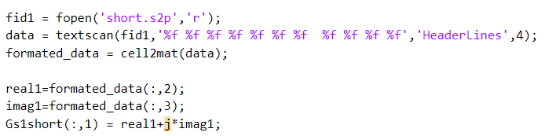
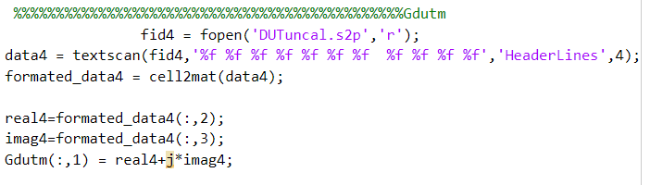
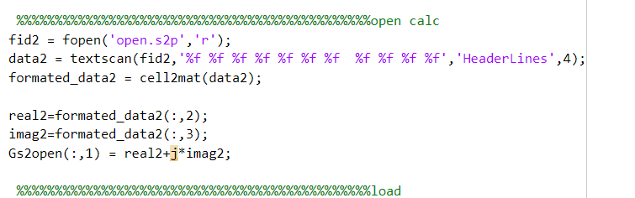
All the measured responses are in the files

Slide 10
Grefl_short – is the ideal short (calculated)
Gs1short – measured short - VNA connected
Grefl_open – ideal open (calculated)
Gs2_open – measured short - VNA connected
Grefl_load – ideal load (calculated)
Gs3_load – measured load - VNA connected

Slide 11
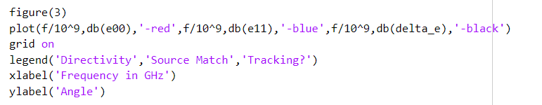
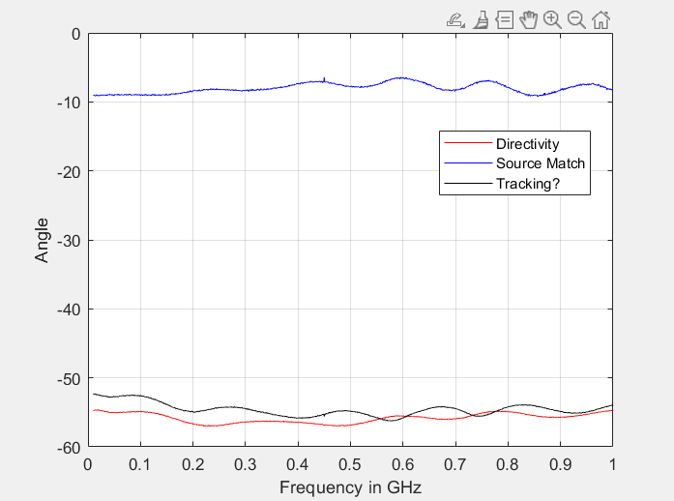
Results for the Pocket VNA
For error terms

Slide 12
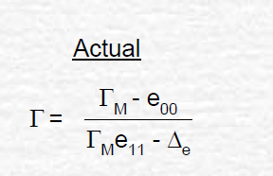

Finally, we just need to remove the error
Where Gdutm – Is the measured DUT

Slide 13
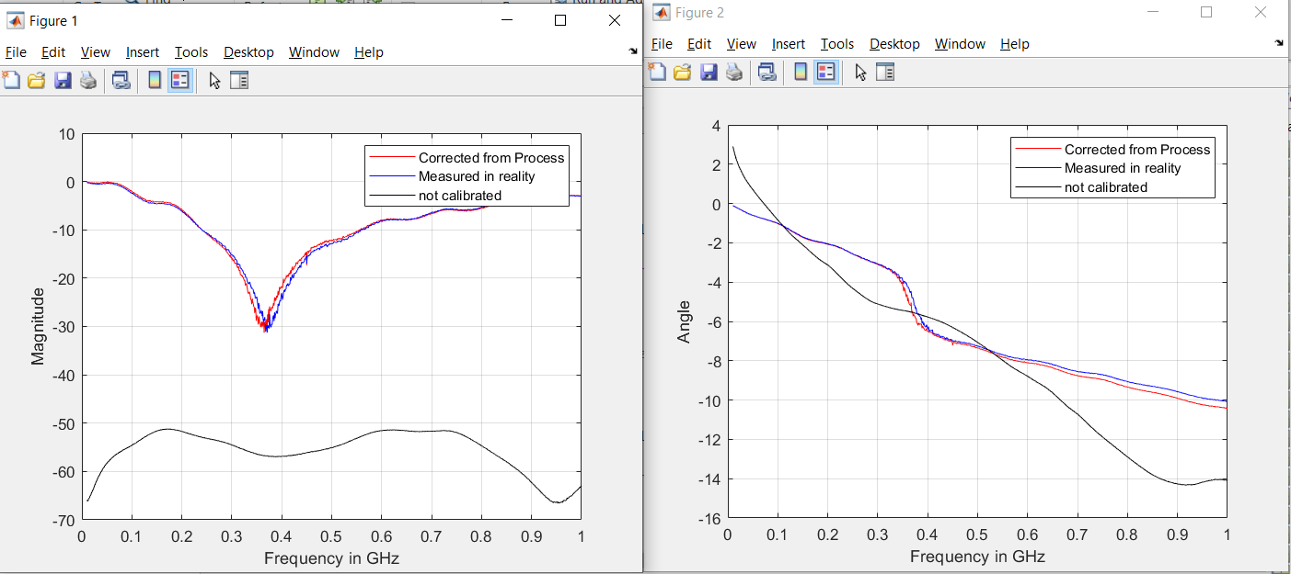
Results for the Pocket VNA

Slide 14
Congratulations – 1 port device is ready

